Slide 1

Project On Weather Image Classification Using Deep Learning
CDAC CHENNAI
Tidel Park, 8th Floor, 'D' Block (North & South), No.4 Rajiv Gandhi Salai, Tiramani, Chennai- 600113, Tamilnadu (India)
Submitted By :
Shivraj Dinkar Shinde (220960825043)
Suhas Suryakant Yadav (220960825044)
Project Guide :
Mr. P. Prasanna

Slide 2
Content
Introduction
Problem Statement
Objective
Project Workflow
Process flow chart
Dataset
Information & Visualization of Dataset
Model Building
Model Comparison
User Interface
Conclusion

Slide 3
Problem Statement
Our project problem statement is “Weather image classification using deep learning”
And the output of the problem statement is to the classification of the weather images given by User.

Slide 4
Objective
The objective of our project is to recognize/classify the weather image as their respective type. For that we are using ML model so the user can get the information about what type of image is.
And weather image classification we are using Convolution Neural Network. CNN contains various architectures within that we are using ResNet50, MobileNet, VGG16, DenseNet201.

Slide 5
Project Workflow
Below diagram shows us our project overflow.
Data Collection
Data
Pre-Processing
EDA
Model Building
UI Construction & Model Implementation

Slide 6
Dataset
Dataset which required for our project, contains 6862 images.
This images is divided into different type of weather images. This images divided into 11 types of images as per weather condition.
This division of the images are as follows:
dew, fog/smog, frost, glaze, hail, lightning , rain, rainbow, rime, sandstorm & snow.

Slide 7
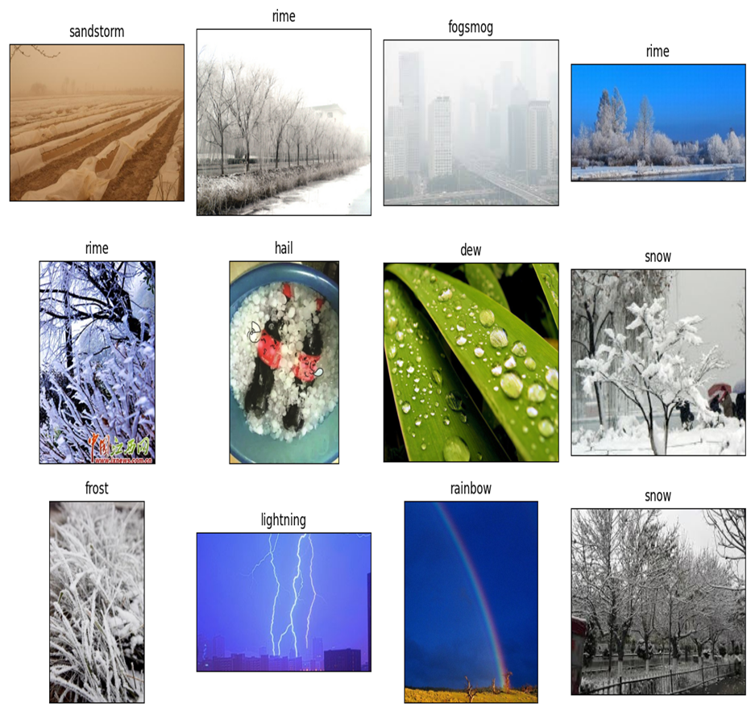
Dataset Visualization
For to extract some useful information we have built some plots that are as follows:

Slide 8
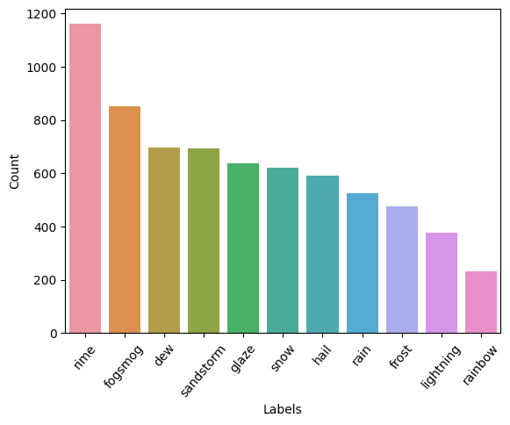
Data Visualization

Slide 9
Model Building
Model building are divide into various parts that are as follows:
Important libraries.
Data augmentation.
Modular utility functions.
Training models.
Models comparison.

Slide 10
Data Augmentation
Data augmentation helps to reduce overfitting when training a deep neural network. In this technique we are creating variation of the images which improve the ability of the fit models to generalize what they have learned to new images.

Slide 11
Modular Utility Functions
We have implemented different function in our project. This functions plays an important role in our project
Functions which we have implemented are as follows:

Slide 12
Training Model
In our project we have use different CNN architecture to classify the image.
And we have use 4 CNN architectures which are as follows:
ResNet50
MobileNet
VGG16
DenseNet

Slide 13
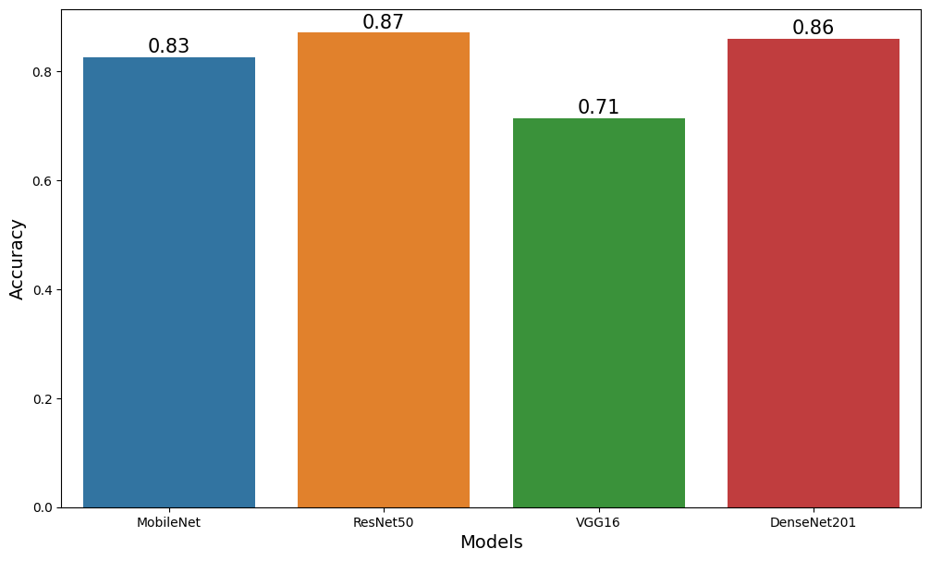
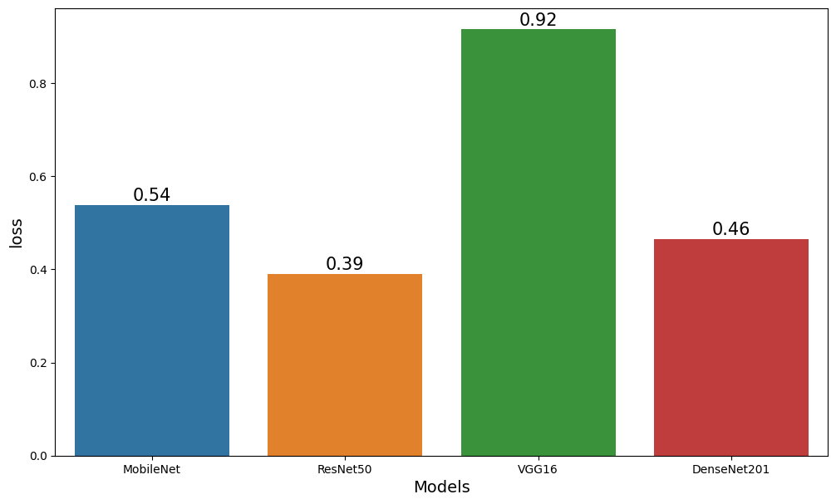
Model Comparison
Comparison on Accuracy
Comparison on Loss

Slide 14
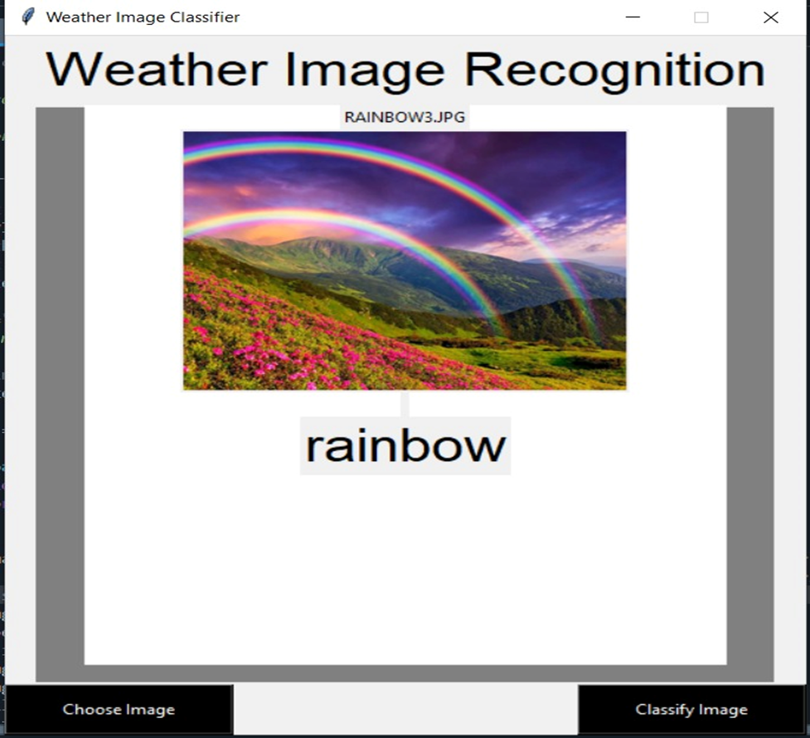
User Interface
With the help of UI we can get the access of the model and we can classify weather images
After applying UI this is how our model classifying the image.

Slide 15
Conclusion
After comparing the model we realise that which model work more efficiently and provide better classification for weather images.
Comparing the model we have come to the conclusion that ResNet having high accuracy and low loss as compare to other model. So we decided to go with ResNet model.

Slide 16
Thank You !

